Slide 1
CMSC201
Computer Science I for Majors
Lecture 24 – Algorithmic Analysis

Slide 2
Last Class We Covered
Sorting algorithms
  Selection Sort
  Bubble Sort
  Quicksort
“Run” time
  Why it’s important

Slide 3
Any Questions from Last Time?

Slide 4
Today’s Objectives
To discuss “run time” of algorithms
  Why one algorithm is “better” than another
To learn about asymptotic analysis
  What it is
  Why it’s important
  How to calculate it

Slide 5

Alphabetizing a Bookshelf
Video from https://www.youtube.com/watch?v=WaNLJf8xzC4

Slide 6
Review: Algorithm Run Time

Slide 7
Example: Sum of All Products
Say we have a list, and we want to find the sum of everything in that list multiplied by everything else in that list
  So if the list is [1, 2, 3], we want to find the value of:
  1*1 + 1*2 + 1*3 + 2*1 + 2*2 + 2*3 +
  3*1 + 3*2 + 3*3
As an exercise, try writing this function!
  def sumOfAllProducts(myList):

Slide 8
Exercise Solution
def sumOfAllProducts(myList):
result = 0
for item in myList:
for item2 in myList:
result += item * item2
return result

Slide 9
Run Time for Sum of All Products
How many multiplications does this have to do for a list of 3 things?
    For 3 things, it does 9 multiplications
  8 things?
    For 8 things, it does 64 multiplications
  16 things?
    For 16 things, it does 256 multiplications
In general, if you give it a list of size N, you’ll have to do N² multiplications!

Slide 10
Run Time for Search
If I am looking through a list of N items…
How long does linear search take?
  N
How long does binary search take?
  lg(N)

Slide 11
Different Run Times
As our list gets bigger and bigger, which of the search algorithms is faster?
  Linear or binary search?
How much faster is binary search?
  A lot!
  But exactly how much is “a lot”?

Slide 12
Asymptotic Analysis

Slide 13
What is “Big O” Notation?
Big O notation is a concept in Computer Science
  Used to describe the complexity
  (or performance) of an algorithm
Big O describes the worst-case scenario
  Big Omega (Ω) describes the best-case
  Big Theta (Θ) is used when the best and worst case scenarios are the same

Slide 14
Asymptotic Analysis
For a list of size N, linear search does N operations. So we say it is O(N) (pronounced “big Oh of n”)
For a list of size N, binary search does lg(N) operations, so we say it is O(lg(N))
For a list of size N, our sum of products function does N² operations, which means it is O(N²)
The function inside the O() parentheses indicates how fast the algorithm scales

Slide 15
Example
What is the big O of the following, given a list of size N:
  for i in myList:
  for j in myList:
  for k in myList:
  print(i*j*k)
This will be O(N³)

Slide 16
Worst-case vs Best-case
Why differentiate between the two?
Think back to selection sort
  What is the best case for run time?
  What is the worst case for run time?
They’re the same!
  Always have to find each minimum by looking through the entire list every time – Θ(N²)

Slide 17
Worst-case vs Best-case
What about bubble sort?
  What is the best case for run time?
  What is the worst case for run time?
Very different!
  Best case, everything is already sorted – Ω( N )
  Worst case, it’s completely backwards – O( N² )

Slide 18
Worst-case vs Best-case
This is why, even though selection sort
and bubble sort have the same run times, bubble sort often runs much faster
How does this apply to linear search and binary search? What are the best and worst run times for these?

Slide 19
Search Run Times
Linear search:
  Best case: Ω( 1 )
  Worst case: O( N )
Binary search:
  Best case: Ω( 1 )
  Worst case: O( lg(N) )

Slide 20
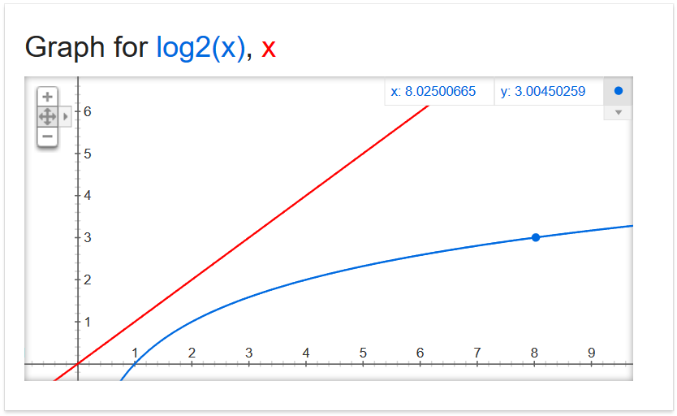
Why Care?

Slide 21
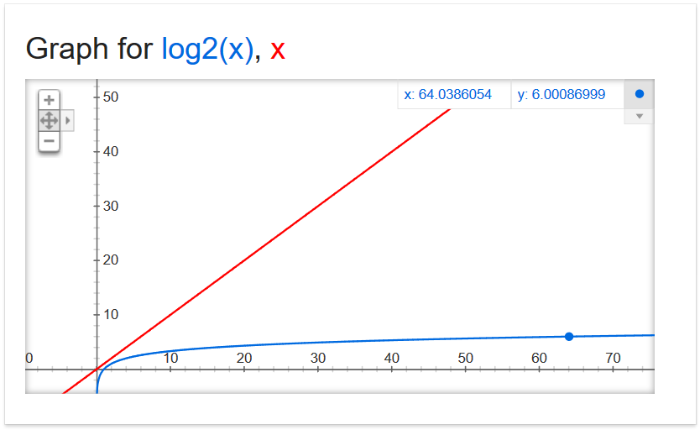
Why Care?

Slide 22
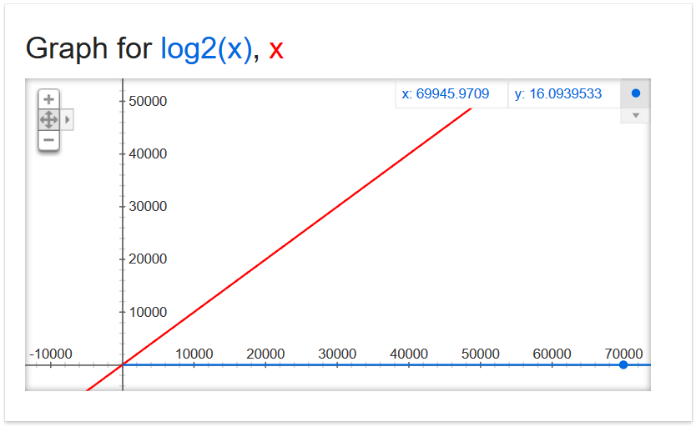
Why Care?

Slide 23
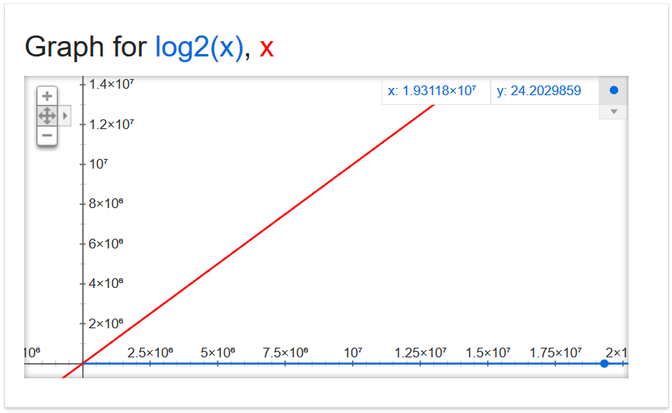
Why Care?
19,311,800

Slide 24
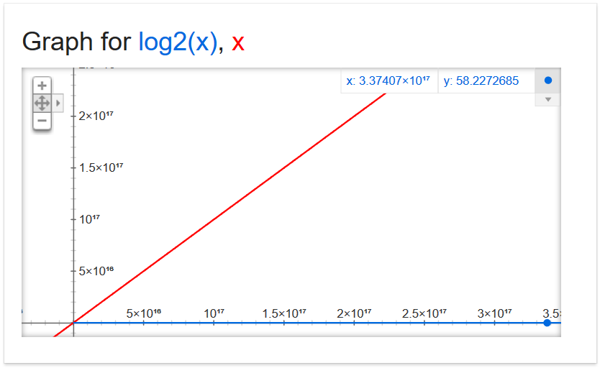
Why Care?
337,407,000,000,000,000

Slide 25
Why Care?
For large problems, there’s a huge difference!
If we can do 1,000,000 operations per second, and the list is 337.4 quadrillion items
  Binary search takes 0.000058 seconds
  Linear search takes 337,407,000,000 seconds
  5,623,450,000 minutes
  93,724,166 hours
  3,905,173 days
  10,699 years

Slide 26
Announcements
Final is when?
  Review worksheet will be released online on Friday,
  so you can start working on it over the weekend
Project 2 out now
  Due on Tuesday, December 13th
Survey #3 also out – follow link in announcement
Now we’ll talk about SEEQs
Thursday, December 15th (3:30 – 5:30)

Slide 27
SEEQs

Slide 28
The Student Evaluation of Educational Quality (SEEQ) is a standardized course evaluation instrument used to provide measures of an instructor’s teaching effectiveness. The results of this questionnaire will be used by promotion and tenure committees as part of the instructor’s evaluation.
The Direct Instructor Feedback Forms (DIFFs) were designed to provide feedback to instructors and they are not intended for use by promotion and tenure committees.
The responses to the SEEQ and the DIFFs will be kept confidential and will not be distributed until final grades are in.

Slide 29

Completing SEEQs
Please take the time now, if you haven’t already, to complete the SEEQ online
You can access it via the link in your email, or
via Blackboard
This is the part →
I will get to see

